Slide 1
Cyber Resilience Act

Slide 2
Introduction & Background
Scope of the legislation
Core Requirements
Agenda
Timeline & Key Focus Areas
Next Steps

Slide 3
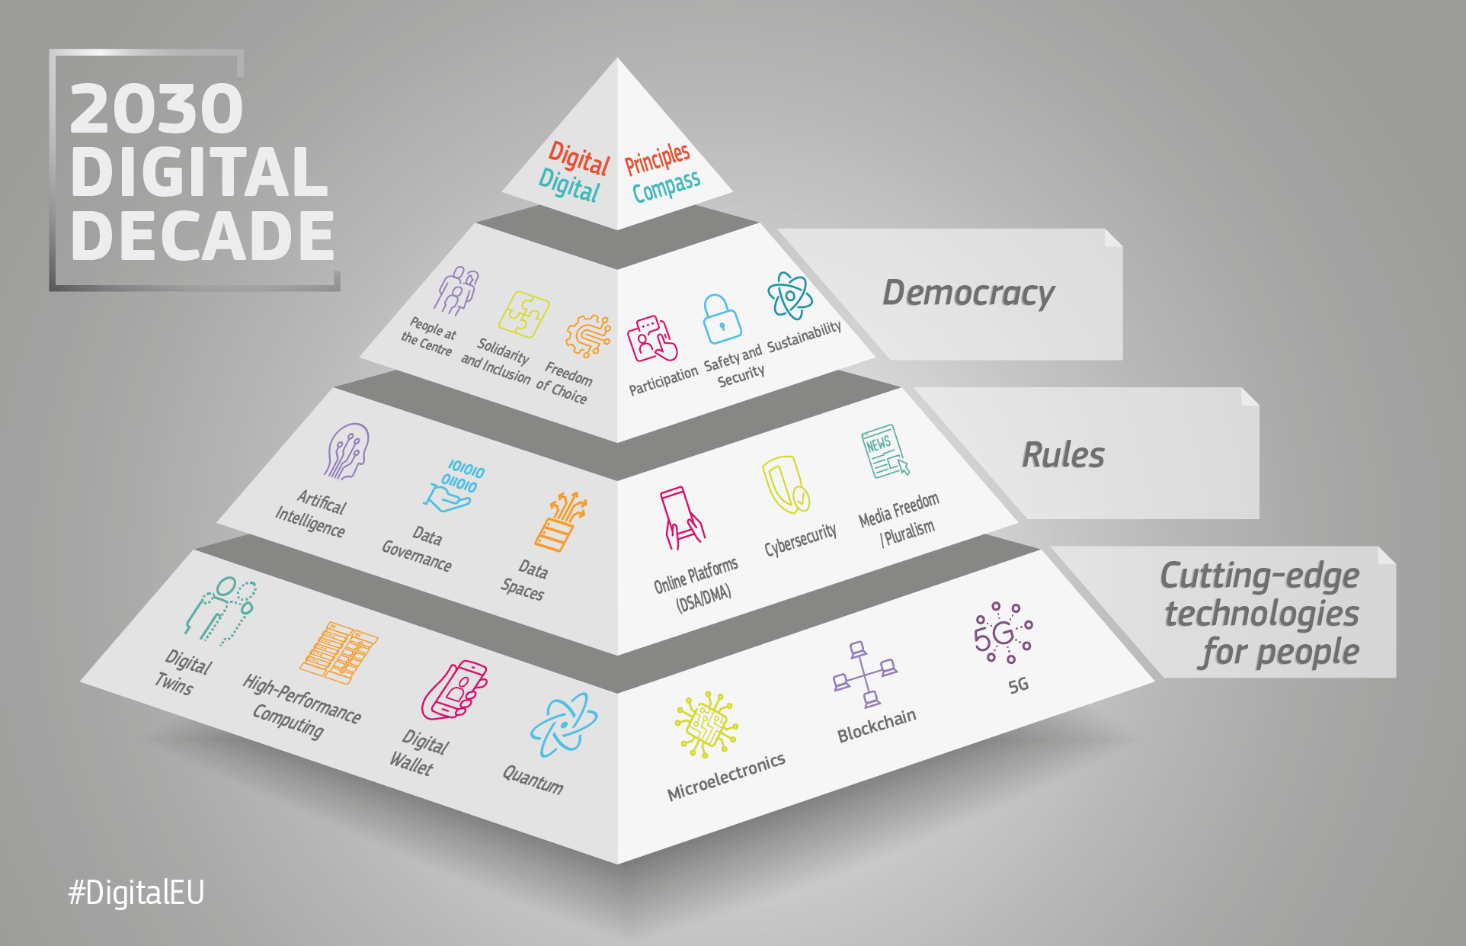

Background
EU Digital Decade
Building a safe and secure digital world
Providing public services online
Ensuring everyone can participate in digital opportunities
Ensuring all organisations adopt cybersecurity measures
Ensuring small businesses and industry can access data and adopt digital technologies
Ensuring SMEs can compete in a digital world on fair terms
Promoting the deployment of innovative infrastructures
Promoting research focused on measuring the impact of digital technologies and developing sustainable, energy and resource efficient innovations
Digital strategy
Data strategy
Cybersecurity strategy
Notes:
Remote data processing makes the distinction between cloud providers (PaaS) and their customers who produce cloud based solutions (SaaS). While NIS2 has a vague definition, the legal interpretation is that it covers the platform providers and not SasS companies. This distinction, “and remote data processing solutions” without which the product won’t work encompasses SaaS solutions. Hardware providers sending software on CDs are covered as a clear hardware/software solution.

Slide 4
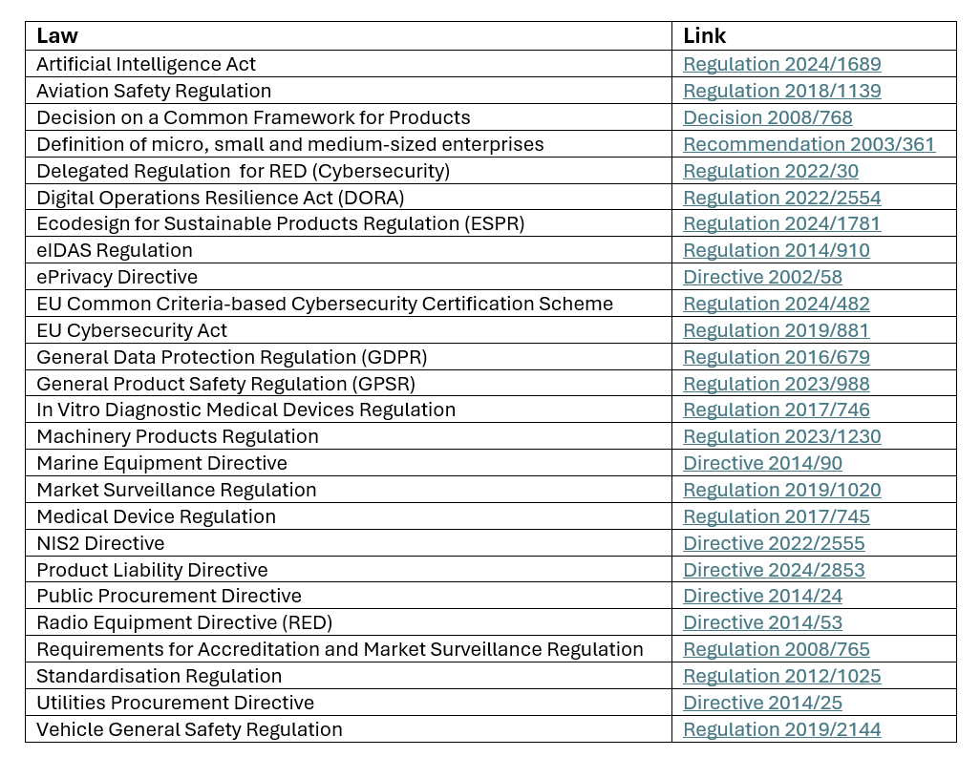
Legislative Framework
Harmonisation of laws
Sector specific laws
aviation
vehicles
marine equipment
medical devices
The CRA refers to many different laws...
Notes:
Harmonisation of laws means that there is an increased scope for security either from sector specific laws, or from updates to the General Product Safety Regulation. Safety now includes being secure – if a product is not secure, it is not safe and can failure to address this can result in a recall or withdrawal from the market i.e. the product cannot be sold in the EU.
Sector specific laws can exempt companies from the CRA provided that the law requires an equivalent level of protection. For example, the Aviation Safety Regulation requires certification of products which would be exempted from the CRA. However, products not certified under that law e.g. drones in the open category (leisure and low-risk commercial activities) may be covered by the CRA.
The Product Liability Directive sets out rules for defective products and establishes the principle the manufacturer is liable irrespective of fault or negligence. The GPSR now includes “secure” in the definition of a safe product.

Slide 5
Scope of the Legislation
A2.1: The Regulation applies to products with digital elements made available on the EU market where the intended purpose, or reasonably foreseeable use of which includes a direct or indirect logical or physical data connection to a device or network.
A3.1: Products with digital elements
”A software or hardware product and its remote data processing solutions, including software or hardware components being placed on the market separately”
A3.2: Remote data processing
”Data processing at a distance for which the software is designed and developed by the manufacturer, or under the responsibility of the manufacturer, and the absence of which would prevent the product with digital elements from functioning”
A3.24: Reasonably foreseeable use
”Use that is not necessarily the intended purpose supplied by the manufacturer in the instructions for use, promotional or sales materials and statements, as well as in the technical documentation, but which is likely to result from reasonably foreseeable human behaviour or technical operations or interactions”
Notes:
A3.2 distinguished between a cloud provider who provides the platform (covered by NIS2) and SaaS providers who, despite the vague wording of NIS2, are deemed not to be managed service providers and aren’t in scope of that legislation. Websites which do not support functionality of a product are not themselves products in scope of the CRA (Recital 12). Where a website provides such functionality, the scope is to the extent of the remote data processing for product functionality. SaaS solutions developed outside of the responsibility of a manufacturer (e.g. may fall outside the scope of the CRA unless they use remote data processing which would make it applicable.
If a device is not intended to connect to another device or network, it is outside the scope e.g. a dishwasher with embedded firmware but no capability to connect to other devices. A washing machine that allows a connection to a diagnostic app on another device would be in scope.
Exemptions apply to products specifically for defence or classified information, or for the manufacture of spare parts to the same specification as those being replaced. Developing products for ones own use is not considered placing on the market and therefore not subject to the CRA.

Slide 6
Roles
Manufacturer
Importer
Distributor
Authorised Representative
A natural or legal person that develops, or manufactures, products with digital elements, or has such products designed, developed and manufactured, and markets them under its name or trademark whether for payment, monetisation or for free.
A natural or legal person, other than the manufacturer, who places on the market a product with digital elements that bears a name or trademark of a natural or legal person established outside of the EU.
A natural or legal person in the supply chain, other than the manufacturer or importer, that makes a product with digital elements available on the market without affecting its properties.
For manufacturers outside of the EU, an authorised representative can be engaged to act on their behalf.
A written mandate is required and the manufacturer must provide all documentation to the representative.
Notes:
The Act includes a role for free and open-source software stewards – where a company takes on support for FOSS that is made available in the course of a commercial activity.
A legal person other than the manufacturer that has the purpose of systematically providing support for the development of specific products with digital elements qualifying as free and open-source software (FOSS) and intended for commercial activities and ensures the viability of those products.

Slide 7
Core Requirements: Manufacturers
Security by design and default approach
Risk assessment & technical documentation
Software Bill of Materials
Due diligence on 3rd party components
Determination of support period
Retention of documentation for support period or 10 years (whichever is longer)
Vulnerability handling processes
Reporting of actively exploited vulnerabilities and significant incidents
Availability of security updates
Conformity assessments and declarations
SPOC
Required provision of information
Notes:
Annex I, Part I contains the cybersecurity requirements, Part II sets out the vulnerability handling requirements
Annex II sets out the required provision of information to customers
Annex VII set out what should be included in the technical documentation

Slide 8
Core Requirements: Importers & Distributors
Due diligence on manufacturer
Pre-market checks
Manufacturer has completed the technical documentation
Conformity assessments and declarations
CE markings
If discovering non-conformity:
Must not sell the product until that is rectified
Must notify the manufacturer
Must notify relevant market surveillance authorities
Document retention:
Must retain technical documentation, conformity assessments and declarations for 10 years after the product is sold or for the length of the support period if it is longer
Must assist market surveillance authorities
Manufacturer ceasing operations
Must notify market surveillance authorities immediately and attempt to notify all users of the situation

Slide 9
Core Requirements: Authorised Representatives
Act according to a written mandate
Must retain documentation for market surveillance authorities for 10 years, or longer if the support period exceeds that time frame
Must assist market surveillance authorities

Slide 10
Free and Open-Source Software (FOSS) Stewards
If a company acts as a FOSS steward, they have specific responsibilities:
They must put in place and document a cybersecurity policy to foster the development of a secure product
Such policy must foster voluntary vulnerability reporting
Must assist market surveillance authorities, including mitigating risks in a product
Reporting obligations only apply to the extent they are involved in devoloping products with digital elements or to the extent severe incidents affect the security of products provided by them
Should avail themselves of voluntary security attestation programmes to assist manufacturer due diligence

Slide 11
Conformity Assessments
Internal control (Module A)
Normal products i.e. not classified important or critical
EU-type examination (Module B) +
Internal production control (Module C)
Important products of Class I if a harmonised standard has not been applied
Full quality control system (Module H)
A manufacturer implements a full quality control system to ensure products comply with the essential requirements
Important products in Class I if a harmonised standard has been applied
Important products in Clas I or II if they are FOSS provided technical documentation is made available to the public
Important products of Class II
Critical products unless a certification scheme is mandatory
A notified body assesses the quality control system, including periodical checks and tests.
Notes:
Product categories are defined in the Annexes:
Important products – class I and II – Annex III
Critical products – Annex IV
Core functionality is the key here – embedding an important or critical product in another doesn’t automatically make the other product important or critical.
The distinction of product categories should be reflected in the manufacturers risk assessments.
Annex V sets out what a declaration of conformity requires, Annex VI allows for a simplified declaration of conformity.
Annex VIII contains the conformity assessment procedures:
Part I – Internal control (Module A) – self-assessment
Part II – EU-type examination (Module B)
Part III – Internal production control (Module C)
Part IV – Full quality assurance (Module H)

Slide 12
Time Frames
The Regulation will apply from 11 December 2027 (A71.1)
However… in A71.2, other dates apply:
Article 14 (Reporting obligations of manufacturers) applies from 11 September 2026
Articles 35-51 (Notification of conformity assessment bodies) applies from 11 June 2026
Notes:
For products placed on the market before 11th December 2027, they will be in scope only if those products are substantially modified after that date. A substantial modification is: A change to a product following its placing on the market which affects the compliance of the product with cybersecurity requirements of this Act, or which results in a modification to the intended purpose for which the product was assessed.
If not update is considered a substantial modification, then the CRA will not apply to products on the market prior to Dec 2027. If the update is, then the CRA will then apply. New units of old products placed after 11 Dec 2027 WILL be subject to CRA requirements.
A14 is a derogation to this rule which requires notification of actively exploited vulnerabilities for all products including those placed on the market before 11 Dec 2027. Manufacturers are obligated by the reporting notifications, but not vulnerability handling requirements of the CRA. CSIRTs may still direct manufacturers to notify users prior to Dec 2027 if they decided not to do so.

Slide 13
Key Focus
Are you ready for the reporting obligations that will start in September?
Do you have clear incident identification and incident handling processes?
Do you know how to report?
Do you know who to report to?
Your role
Are you clear what role you fulfill under the CRA?
Are you clear of what all your obligations are?
Do you know where you are and what needs to be done to ensure compliance?
Conformity
Do you know what your product will be classified as under the CRA? i.e. normal, important or critical
Do you know what conformity assessment you would use? e.g. self assessment or notified body
Are you prepared to make conformity declarations? e.g. do you have all the necessary documentation?

Slide 14
Determine whether the CRA applies
1
Determine your role
2
Determine your obligations
Next steps
3
Conduct a gap analysis
4
Develop an implementation plan
5
Notes:
The next webinar, on 28th April, will look in more detail at how to carry out steps 3, 4 and 5. We will look in more detail at the essential requirements, conformity assessment modules, use of harmonised standards, and practical measures to help prepare for the law.

Slide 15

We’re happy to help
Need compliance? Gap analysis towards CRA (optionally combined with other legislation such as NIS2), assessing your current setup against CRA requirements, identifying compliance gaps and recommended actions.
Not sure if you’re subject to this regulation yet? Legal assessment to determine whether your organization falls within the scope of CRA and other applicable regulations. Right now we offer 10% discount on our fixed price.

Slide 16
Any questions?

